Slide 1
INTRODUCTION
NAME - AMAN PANDEY
UNIVERSITY ROLL – 22020107029
COLLEGE ROLL – 20222709
COURSE - BVOC (S.D)
SUBJECT - MINOR PROJECT
PROJECT - WEATHER REPORT
GIT HUB LINK -https://github.com/aman221717/Weather-Report
SUMBITTED TO: VIPIN RATHI SIR

Slide 2
Table of Contents:
1. Demo
2. Features
3. Technologies Used
4. How to Use.

Slide 3
DEMO-
A simple weather application that allows users to check the current weather conditions for a specific location.
It Header and Navigation: It features a responsive navigation bar that includes links to various sections like the homepage, current weather, weather forecast, news, and a weather map. Users can search for weather data by location.
Current Weather Section: Displays current weather information such as location, temperature, wind speed, humidity, and weather conditions (e.g., cloudy, sunny). It also provides a table with detailed weather data, including time zone, region, and coordinates (latitude and longitude).
Weather Forecast Section: Provides a weather forecast for the upcoming days. Users can input start and end dates to search for specific weather forecasts, along with corresponding weather icons.
Weather Map Section: Displays an interactive weather map for users to explore global weather conditions.

Slide 4
FEATURES
TECHNOLOGIES USED
Display current weather conditions (temperature, description, etc.).
Search for weather by location.
Responsive design for various devices.
HTML
CSS
JavaScript.

Slide 5
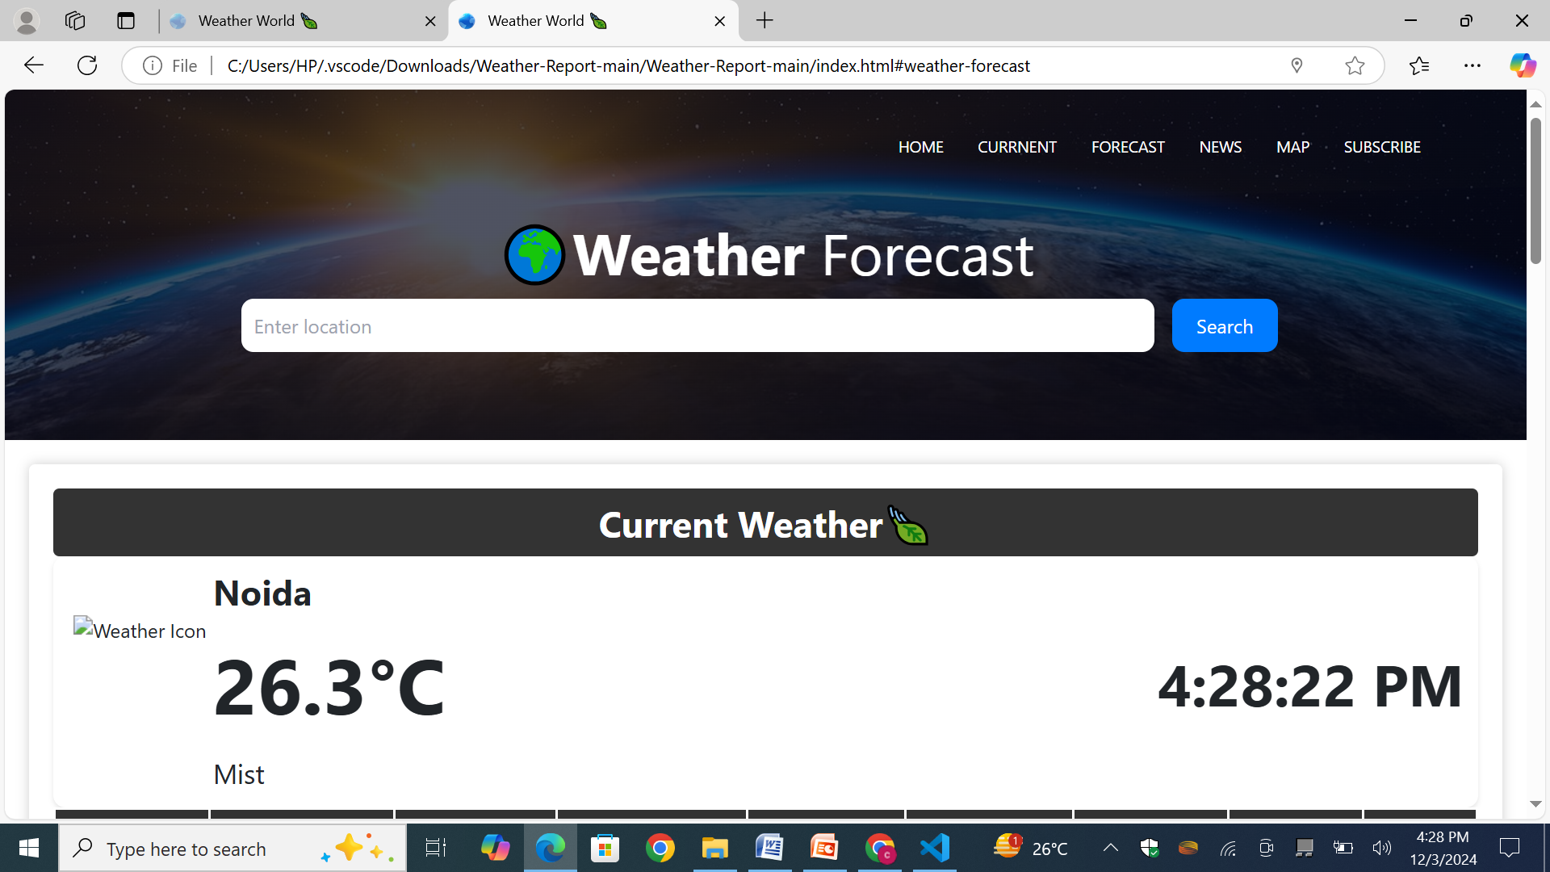
HOW TO USE-
1. Open the index.html file in a web browser.
2. Enter the desired location in the search bar.
3. Click the "Search" button to retrieve and display the weather information.

Slide 6
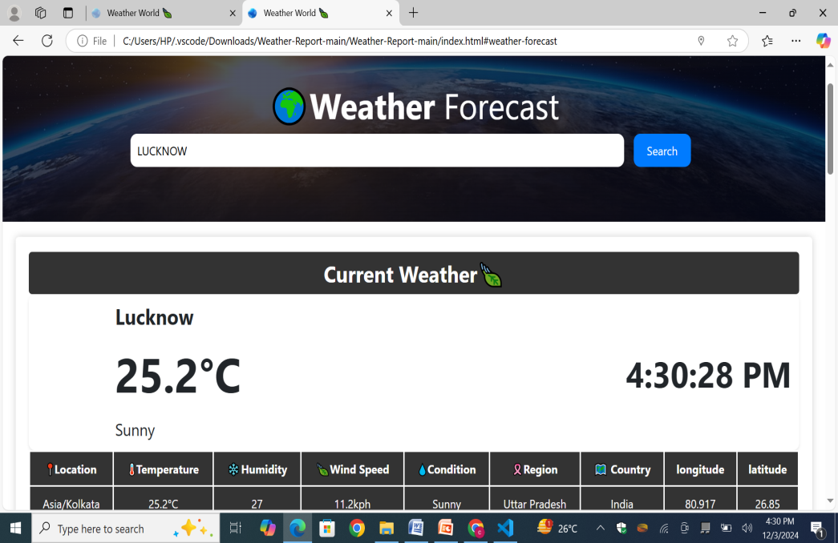
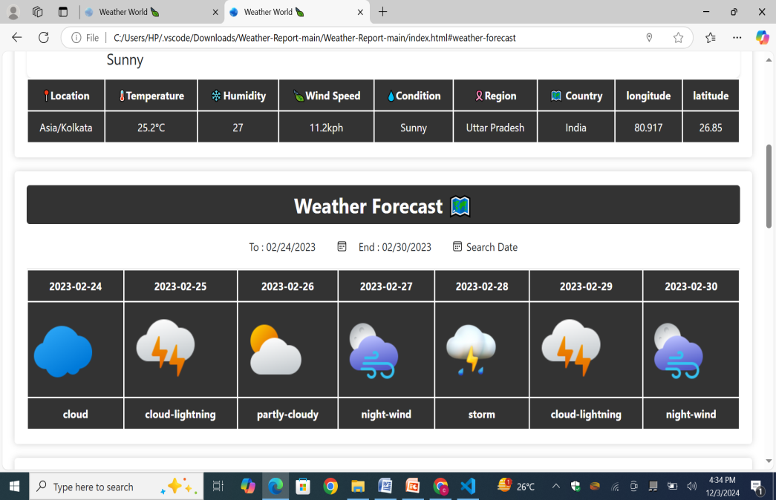
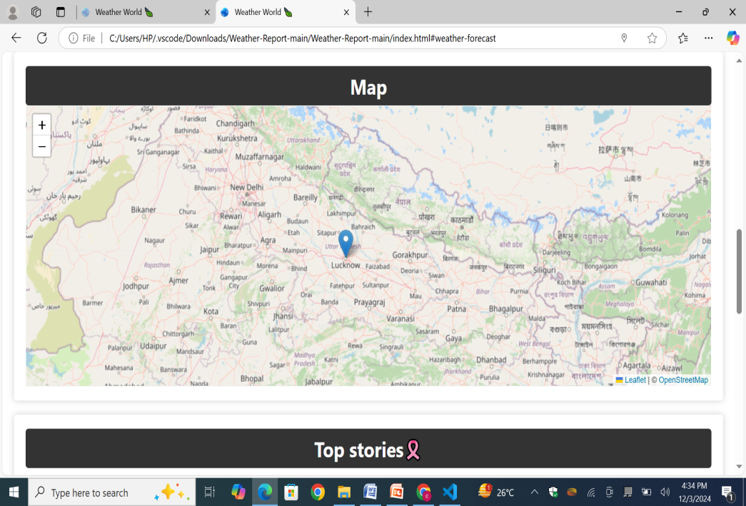
1.
OUTPUT :

Slide 7
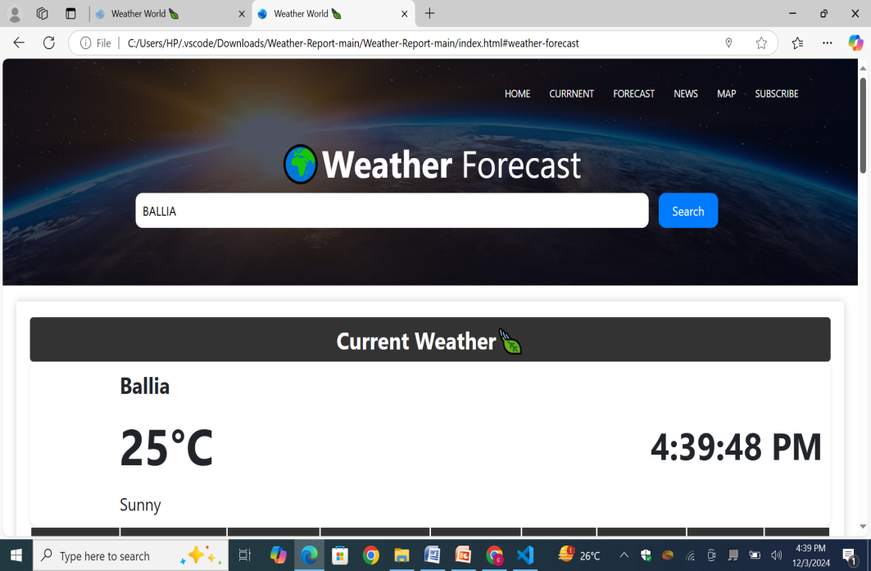
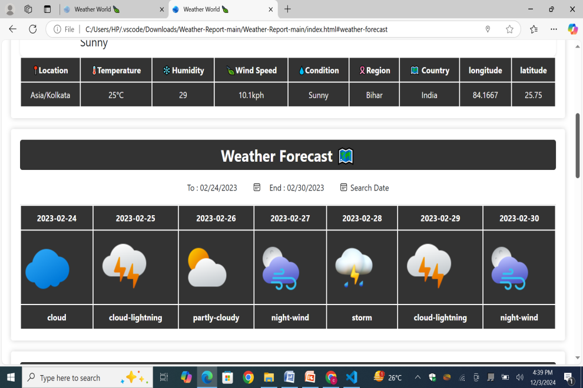
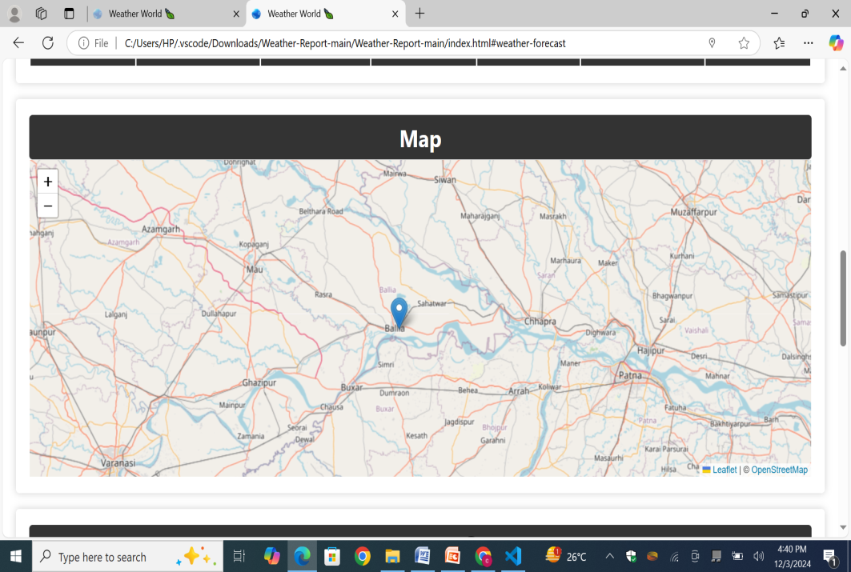
2.

